Slide 1
Data Collection Techniques and ANOVA Test

Slide 2
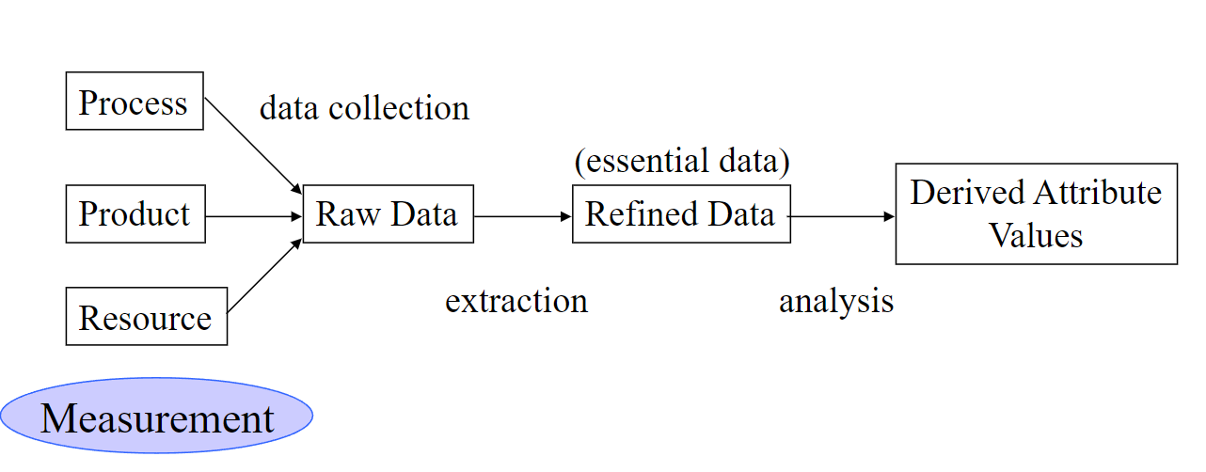
Software Metrics Data Collection

Slide 3
What is Good Data?
Are they correct?
Are they accurate?
Are they appropriately precise?
Are they consistent?
Are they associated with a particular activity or time period?
Can they be replicated?

Slide 4
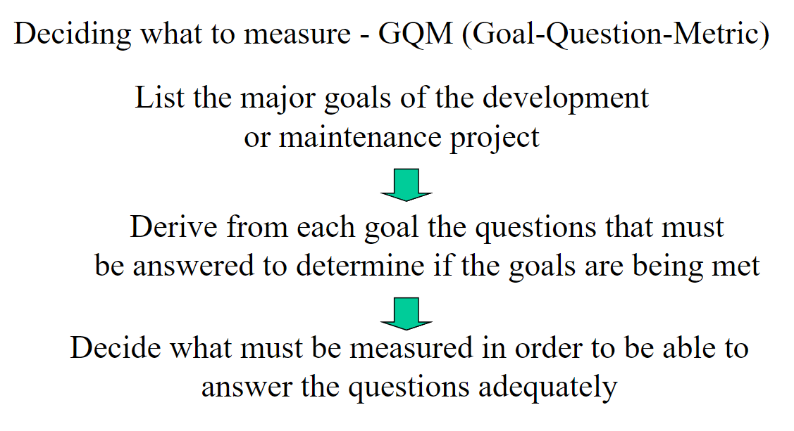
How to Define the Data

Slide 5
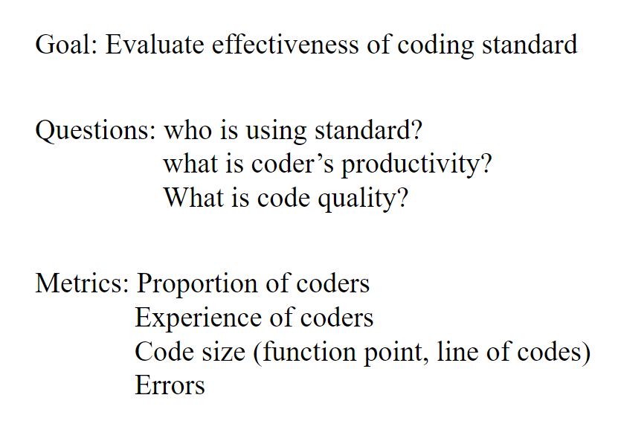
How to Define the Data

Slide 6
Data Collection Techniques for Software Field Studies
Interviews and questionnaires are the most straightforward instruments, but the data they produce typically present an incomplete picture.
For example, assume your goal is to assess which programming language features are most error-prone. A developer can give you general opinions and anecdotal evidence about this; however, you would obtain far more accurate information by recording and analyzing the developer’s work practices - their efforts at repeatedly editing and compiling code
To learn about different aspects of a phenomenon, it is often best to use multiple data collection methods

Slide 7
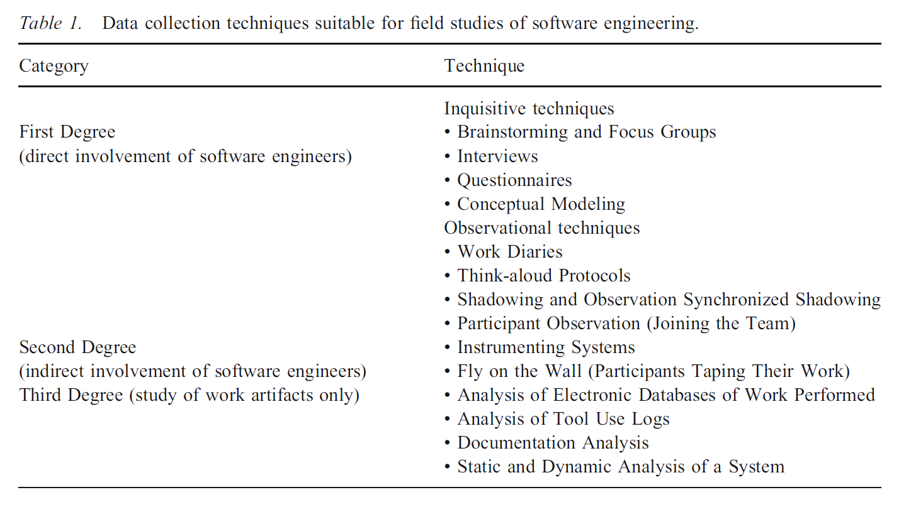
A Taxonomy of Data Collection

Slide 8
Data Collection Techniques
First degree: Evaluators or researchers directly interact with developers. They may interview developers, observe them working, or interact directly with developers daily.
Second degree: Evaluators or researchers indirectly interact with developers. They may use software development tools to collect information or record meetings or other development activities.
Third degree: Evaluators have no interactions with developers. Rather, they study artifacts such as revision control system records, fault reports and responses, testing records, etc. Third-degree studies can be performed retrospectively.

Slide 9
Some Definitions
A work diary protocol for a study involves providing participants with guidelines and instructions for maintaining a journal or diary where they document their daily work activities, tasks, thoughts, and reflections. The collected data from these diaries is then analyzed to gain insights into participants' work processes, decision-making, challenges, and experiences
A think-aloud study is a research method in which participants verbalize their thoughts, reactions, and decision-making processes while performing a specific task or solving a problem.
Shadowing and observation a research method where a researcher closely follows and observes a participant as they go about their daily activities or tasks. Researchers use this method to collect data by directly observing participants without direct involvement.

Slide 10
Definitions
Fly-on-the-wall research is an observational technique that allows a researcher to collect data by seeing and listening. Usually, researchers employ this method to gain insight into people, environment, interactions and objects in a space. It is the primary responsibility of the researcher to stay completely unnoticed during the observation so as to not bias the participants in any way.
The selection of a data collection method should be done in the context of a research goal or question.

Slide 11
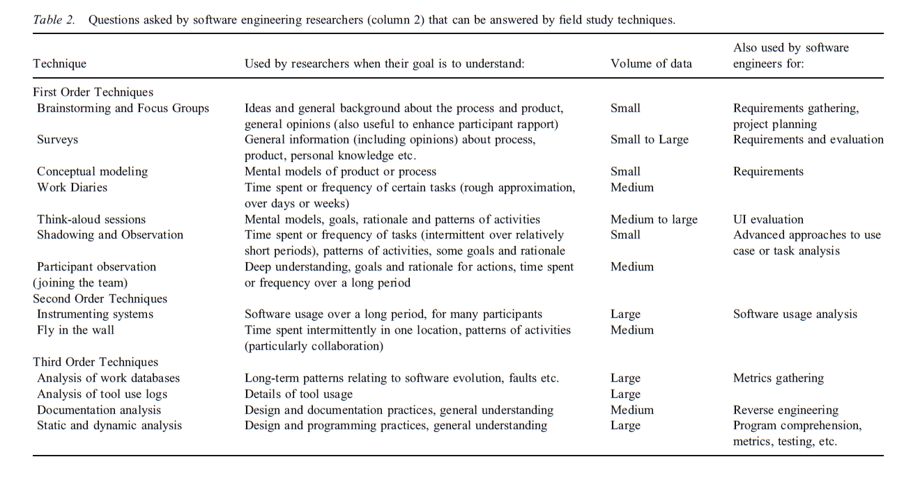

Slide 12
ANOVA Test
Student T-test
One-way ANOVA Test

Slide 13
One-Way ANOVA
One-way analysis of variance (ANOVA) is a statistical method for testing for differences in the means of three or more groups.
One-way ANOVA is typically used when you have a single independent variable or factor. The independent variable divides cases into two or more mutually exclusive levels, categories, or groups. Your goal is to investigate if variations or different levels of that independent variable or factor have a measurable effect on a dependent variable.
One-way ANOVA can only be used when investigating a single factor and a single dependent variable. When comparing the means of three or more groups, it can tell us if at least one pair of means is significantly different, but it can’t tell us which pair.

Slide 14
One-Way ANOVA (cont..)
One-way ANOVA is a test for differences in group means
One-way ANOVA is a statistical method to test the null hypothesis (H₀) that three or more population means are equal vs. the alternative hypothesis (H_{a}) that at least one mean is different.

Slide 15
Examples
1# Your independent variable is social media use, and you assign groups to low, medium, and high levels of social media use to find out if there is a difference in hours of sleep per night.
2# Your independent variable is brand of soda, and you collect data on Coke, Pepsi, Sprite, and Fanta to find out if there is a difference in the price per 100ml.
3# You independent variable is type of fertilizer, and you treat crop fields with mixtures 1, 2 and 3 to find out if there is a difference in crop yield.

Slide 16
Example
Imagine you work for a company that manufactures an adhesive gel that is sold in small jars. The viscosity of the gel is important: too thick and it becomes difficult to apply; too thin and its adhesiveness suffers. You've received some feedback from a few unhappy customers lately complaining that the viscosity of your adhesive is not as consistent as it used to be. You've been asked by your boss to investigate.
You decide that a good first step would be to examine the average viscosity of the five most recent production lots. If you find differences between lots, that would seem to confirm the issue is real. It might also help you begin to form hypotheses about factors that could cause inconsistencies between lots.

Slide 17
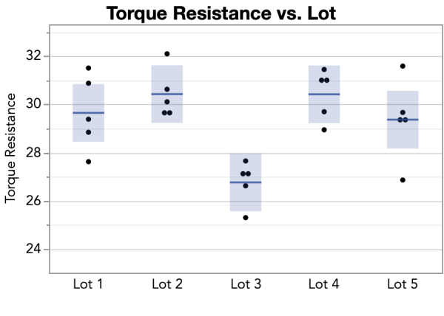
You measure viscosity using an instrument that rotates a spindle immersed in the jar of adhesive. This test yields a measurement called torque resistance. You test five jars selected randomly from each of the most recent five lots

Slide 18
Table 1: Mean torque measurements from tests of five lots of adhesive
Lot # | N | Mean
1 | 5 | 29.65
2 | 5 | 30.43
3 | 5 | 26.77
4 | 5 | 30.42
5 | 5 | 29.37

Slide 19
Table 2: ANOVA table with results from our torque measurements
Source | DF | Sum of Squares | Mean Square | F Ratio | Prob-> F
Lot | 4 | 45.25 | 11.31 | 6.90 | 0.0012
Error | 20 | 32.80 | 1.64
Total | 24 | 78.05

Slide 20
One key element in this table to focus on for now is the p-value. The p-value is used to evaluate the validity of the null hypothesis that all the means are the same. In our example, the p-value (Prob-> F) is 0.0012. This small p-value can be taken as evidence that the means are not all the same
Remember, an ANOVA test will not tell you which mean or means differs from the others, and (unlike our example) this isn't always obvious from a plot of the data
Hypothesis: the viscosity of the adhesive is not consistent among different lots
Null Hypothesis: the viscosity of the adhesive is consistent in all lots

Slide 21
One-way ANOVA calculation
Table 3: Torque measurements by Lot
 | Lot 1 | Lot 2 | Lot 3 | Lot 4 | Lot 5
Jar 1 | 29.39 | 30.63 | 27.16 | 31.03 | 29.67
Jar 2 | 31.51 | 32.10 | 26.63 | 30.98 | 29.32
Jar 3 | 30.88 | 30.11 | 25.31 | 28.95 | 26.87
Jar 4 | 27.63 | 29.63 | 27.66 | 31.45 | 31.59
Jar 5 | 28.85 | 29.68 | 27.10 | 29.70 | 29.41
Mean | 29.65 | 30.43 | 26.77 | 30.42 | 29.37

Slide 22
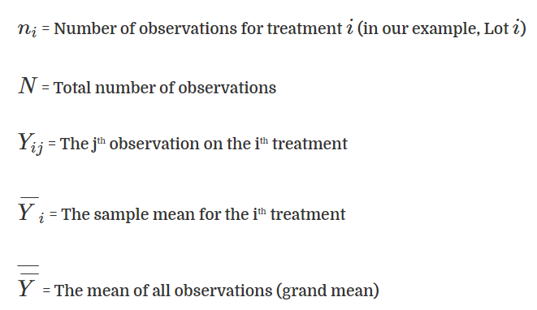

Slide 23
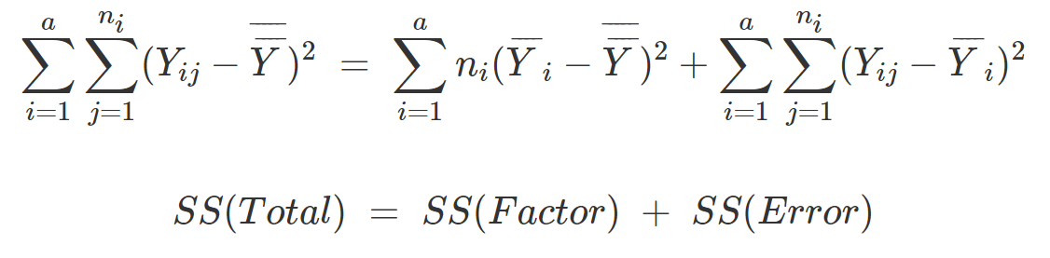
Sum of Squares
The sum of squares gives us a way to quantify variability in a data set by focusing on the difference between each data point and the mean of all data points in that data set. The formula below partitions the overall variability into two parts: the variability due to the model or the factor levels, and the variability due to random error.

Slide 24
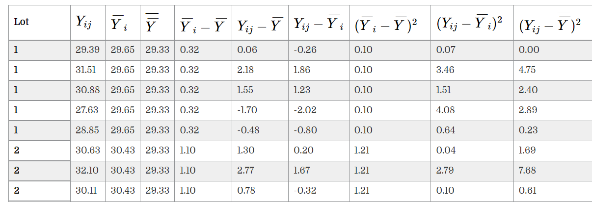
.
..

Slide 25
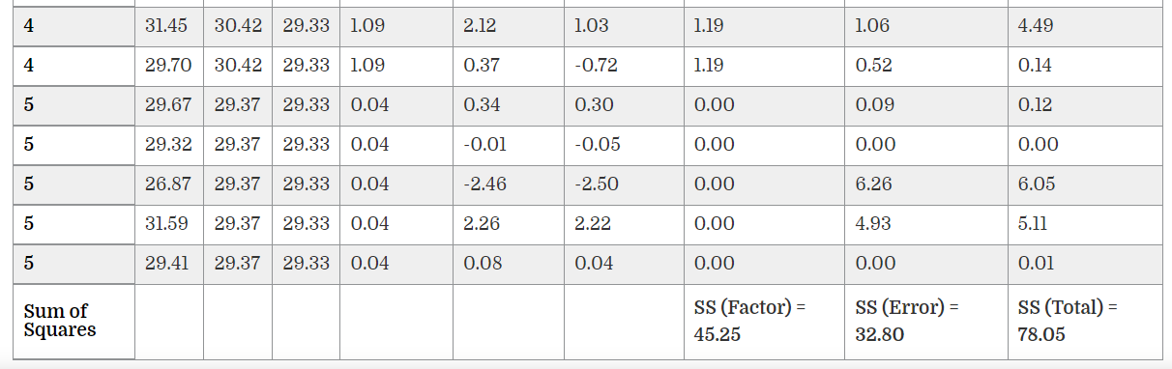
.
.

Slide 26
Degrees of Freedom (DF)
The number of values that are free to vary in a data set
The degrees of freedom indicates the number of independent pieces of information used to calculate each sum of squares.
For a one-factor design with a factor at k levels (five lots in our example) and a total of N observations (five jars per lot for a total of 25), the degrees of freedom are as follows:
 | Degrees of Freedom (DF) Formula | Calculated Degrees of Freedom
SS (Factor) | k - 1 | 5 - 1 = 4
SS (Error) | N - k | 25 - 5 = 20
SS (Total) | N - 1 | 25 - 1 = 24

Slide 27
Mean Squares (MS) and F Ratio
We divide each sum of squares by the corresponding degrees of freedom to obtain Mean Squares (MS). When the null hypothesis is true (i.e. the means are equal), MS (Factor) and MS (Error) are both would be about the same size. Their ratio, or the F ratio, would be close to one. When the null hypothesis is not true then the MS (Factor) will be larger than MS (Error) and their ratio greater than 1. In our adhesive testing example, the computed F ratio, 6.90, presents significant evidence against the null hypothesis that the means are equal.

Slide 28
Table 6: Calculating mean squares and F ratio
 | Sum of Squares (SS) | Degrees of Freedom (DF) | Mean Squares | F Ratio
SS (Factor) | 45.25 | 4 | 45.25/4 = 11.31 | 11.31/1.64 = 6.90
SS (Error) | 32.80 | 20 | 32.80/20 = 1.64

